Slide 1

Visual Studio
For Hackathon 2019
By William M Mortl, Amanda Kaufman, Mark Bishop, Shruti Pathak, Devanshi Patel, and Craig Riter

Slide 2
Cloud Computing – The Good
Cloud computing promises to make developing apps at scale easier
Deploy and leave it up to ”the experts” to manage the infrastructure
Existing apps in private data centers can be ported to Azure

Slide 3
Cloud Computing – The Bad
Current distributed application developers that use Microsoft technologies struggle to adapt to Azure
Developers are familiar with using MMC snap-ins to manage Windows Server infrastructure – Azure doesn’t have similar management tools and patterns

Slide 4
Cloud Computing – The Ugly
Arcane command line incantations via the Azure CLI
YAML is not intuitive
ARM templates are impossible to memorize the structure of
Repurposing old YAML and ARM, which leads to…
Typos 🤮

Slide 5
Cloud Computing in Industry
Developers are already in demand (read: expensive) in the US
Long time Microsoft business application developers don’t necessarily understand the intricacies of Azure development (while understanding classical distributed systems with VMs)
They already understand Windows Server management tools
After talking with Walmart developers in Bentonville, and former colleagues at JP Morgan Chase – both say the same thing:
“I am familiar with Windows Server management and MMC based tools, but Azure is such a different beast”

Slide 6
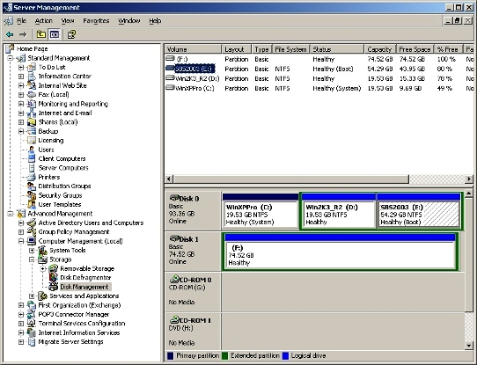
Windows Server Management

Slide 7
Cloud Computing in Industry, Cont.
What could separate Azure from AWS and GCP? Reducing the friction of transitioning to serverless cloud computing
Cloud computing, not to mention serverless computing is disruptive, when did we see this before? Web applications
How did Microsoft ease the transition from desktop to web applications?

Slide 8
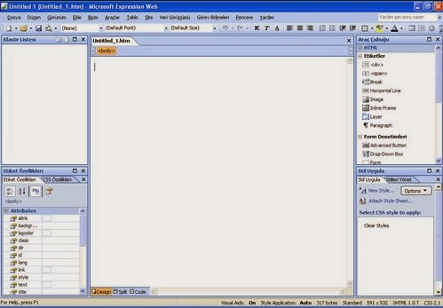
Microsoft Frontpage

Slide 9
Microsoft’s Mission & Azure
Microsoft’s corporate mission is to empower every person and every organization on the planet to achieve more
For Azure to achieve this lofty ideal - a better, more familiar graphical experience is needed for some long-time Microsoft developers

Slide 10
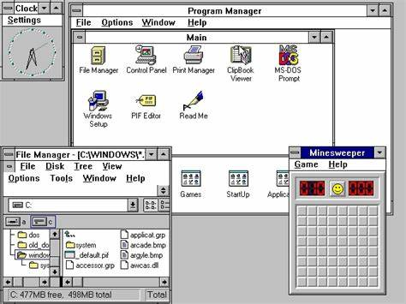
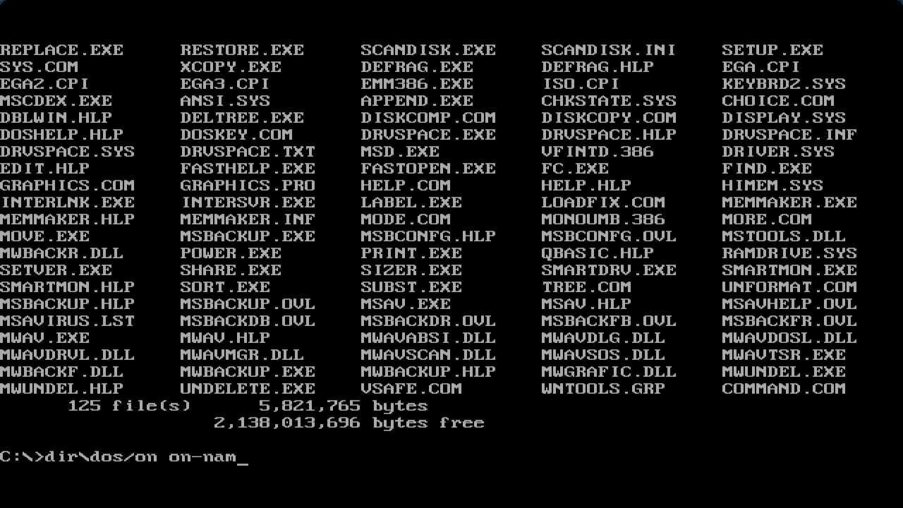
Moved Once From Text to GUI Once Before

Slide 11
The Solution?
Create a visual design tool for Azure which adopts time-honored Microsoft visual design metaphors
Draw your Azure infrastructure
Configure infrastructure properties like you would configure elements of a Windows form
Export industry-standard config files & scripts

Slide 12
Visual Azure Studio – Hackathon Preview
Demo

Slide 13
Going Forward…
Invest more time in a full, modern, and robust application
Build Visual Azure Studio using the electron application framework (similar to Visual Studio Code), this ensures…
Multi-platform: Windows, Linux, and Mac

Slide 14
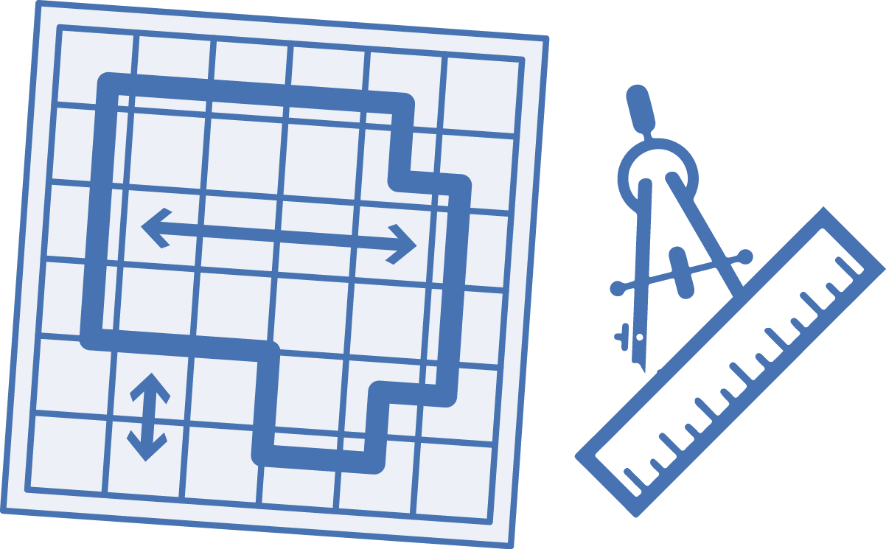




Visual Azure Studio - Workflow
ARM
Visual Azure Studio
ARM
Terraform
Import
or
YAML
Create schematic
.ps1
.sh
or
Execute script
Resources created

Slide 15
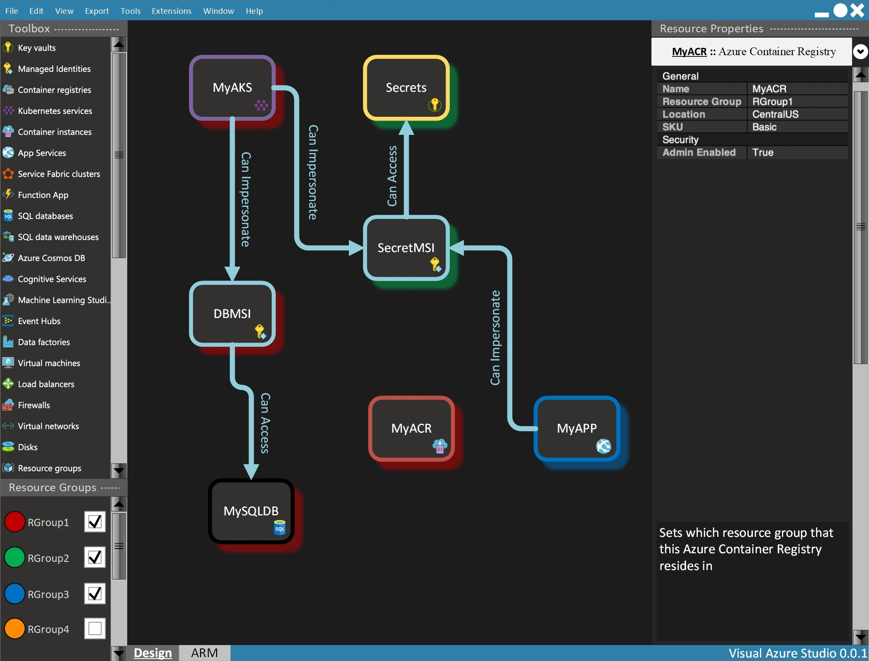

Slide 16
Thank You!
Thank you from the whole Visual Azure Studio Hackathon 2019 team!
William M Mortl
Amanda Kaufman
Mark Bishop
Shruti Pathak
Devanshi Patel
Craig Riter
https://github.com/williammortlmicrosoft/visualazurestudio

